Slide 1
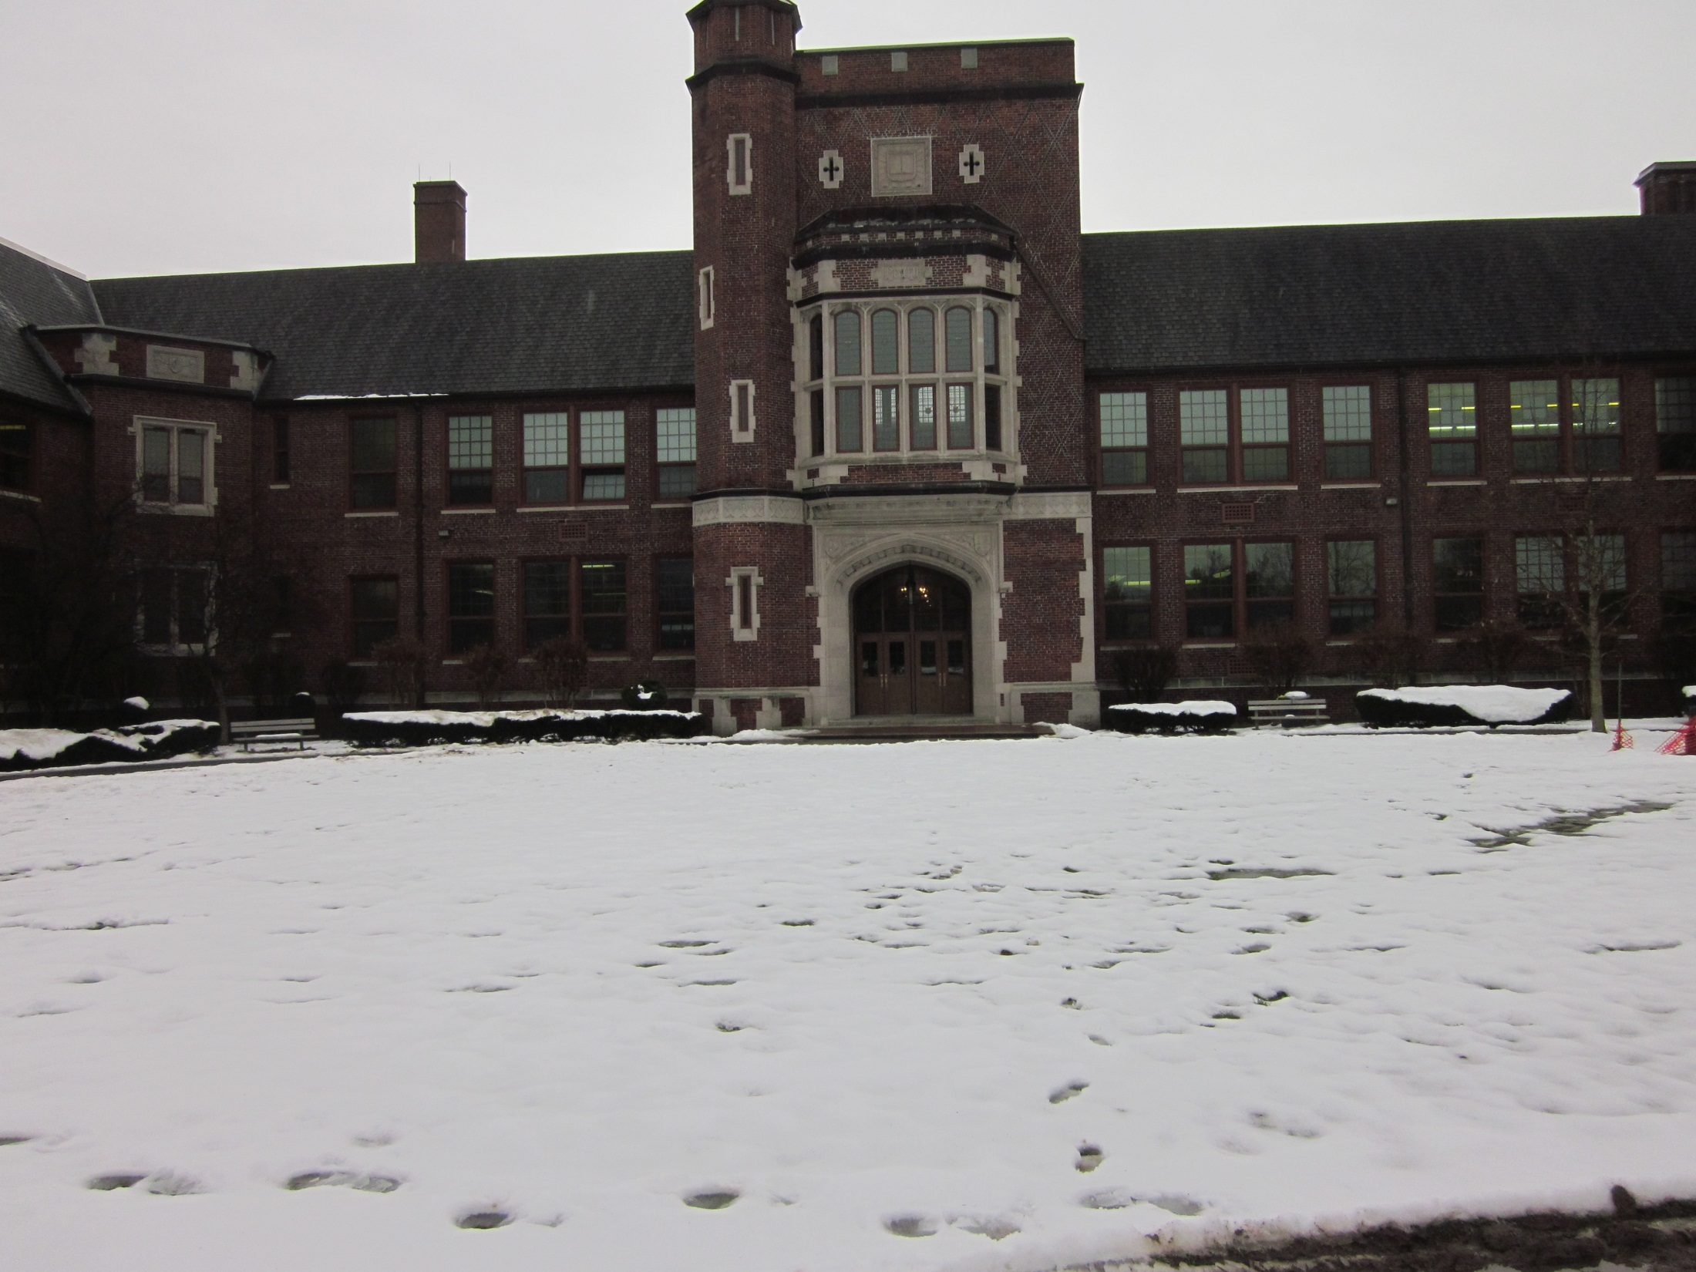
Beaty-Warren Middle School
2013-2014
6th Grade Assignment
February 28, 2013
Mrs. Decker, Principal

Slide 2
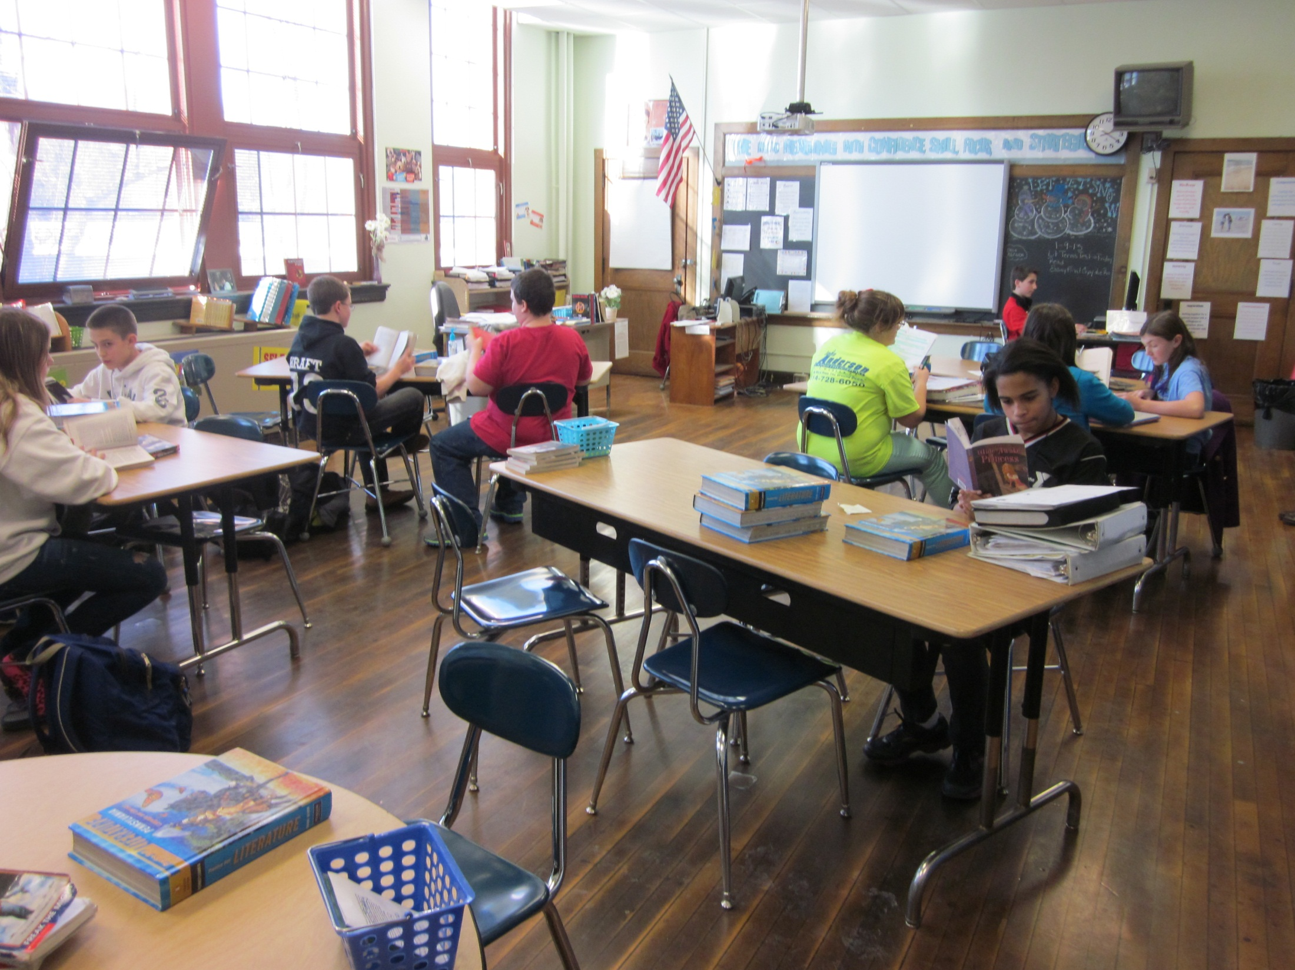
6th Grade Core Classes:
Some classes would be held in rooms “split” by room dividers
Science- Band Room
Language Arts- Art Room
Social Studies- Chorus Room
Math-would be in individual classrooms

Slide 3
Special Education Classrooms
Life Skills Support
One large room
Kitchen, restroom facilities
Smaller room for small group instruction
Learning Support/Emotional Support/Autistic Support
Will share divided rooms

Slide 4
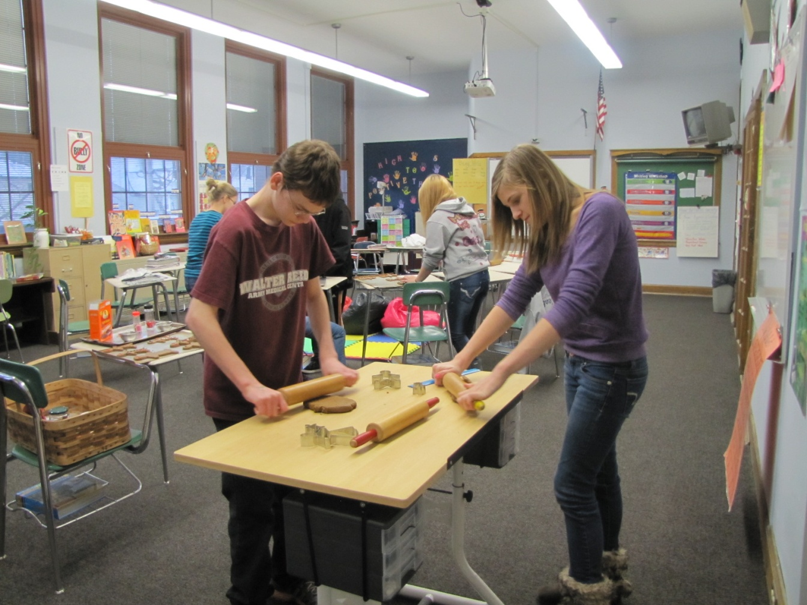
Family Consumer Science, Art, Health and 6th grade Library will be “on a cart” using core teachers’ rooms.

Slide 5
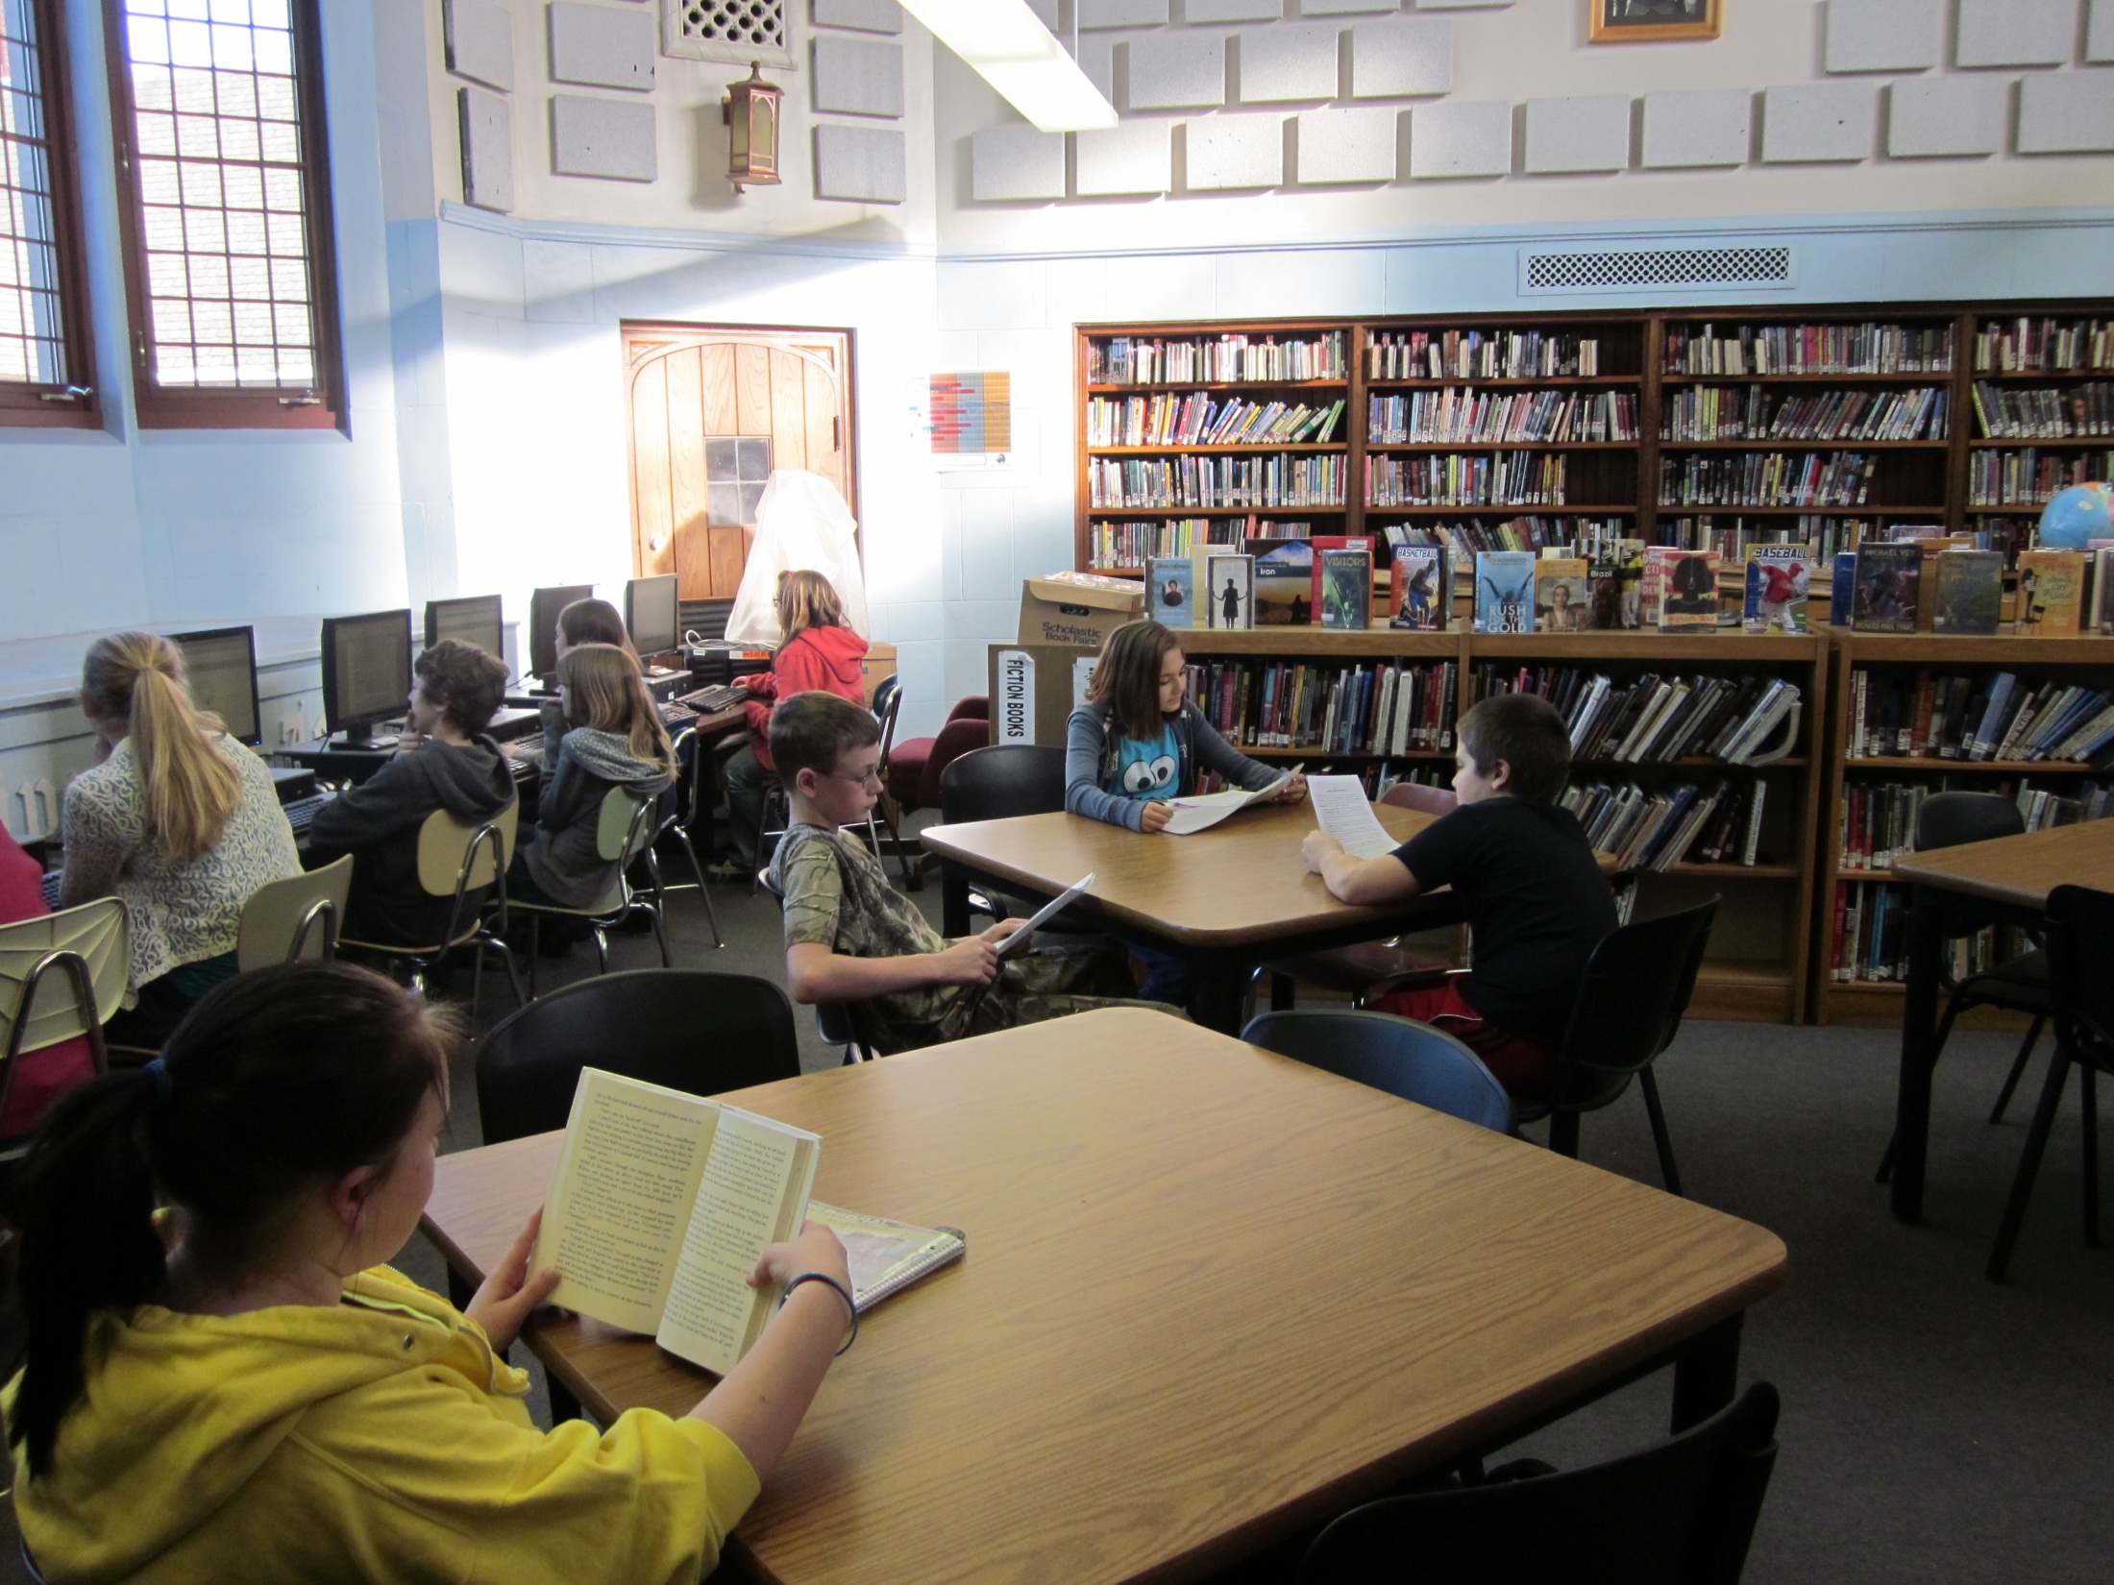
The Media Center will be used as a library, and other purposes such as - exploratory classes, computer access for content areas, and an office area for administration and guidance.

Slide 6
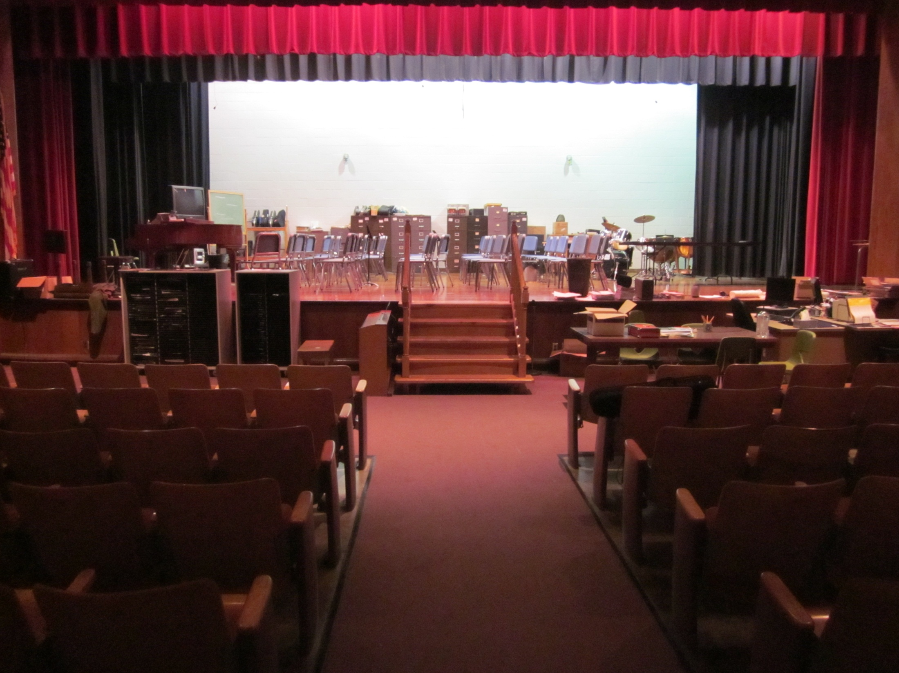
The auditorium will continue to serve as the band, chorus, and orchestra room.

Slide 7
NURSING Services
Will be located on the first floor in an area that will be a conference room.

Slide 8
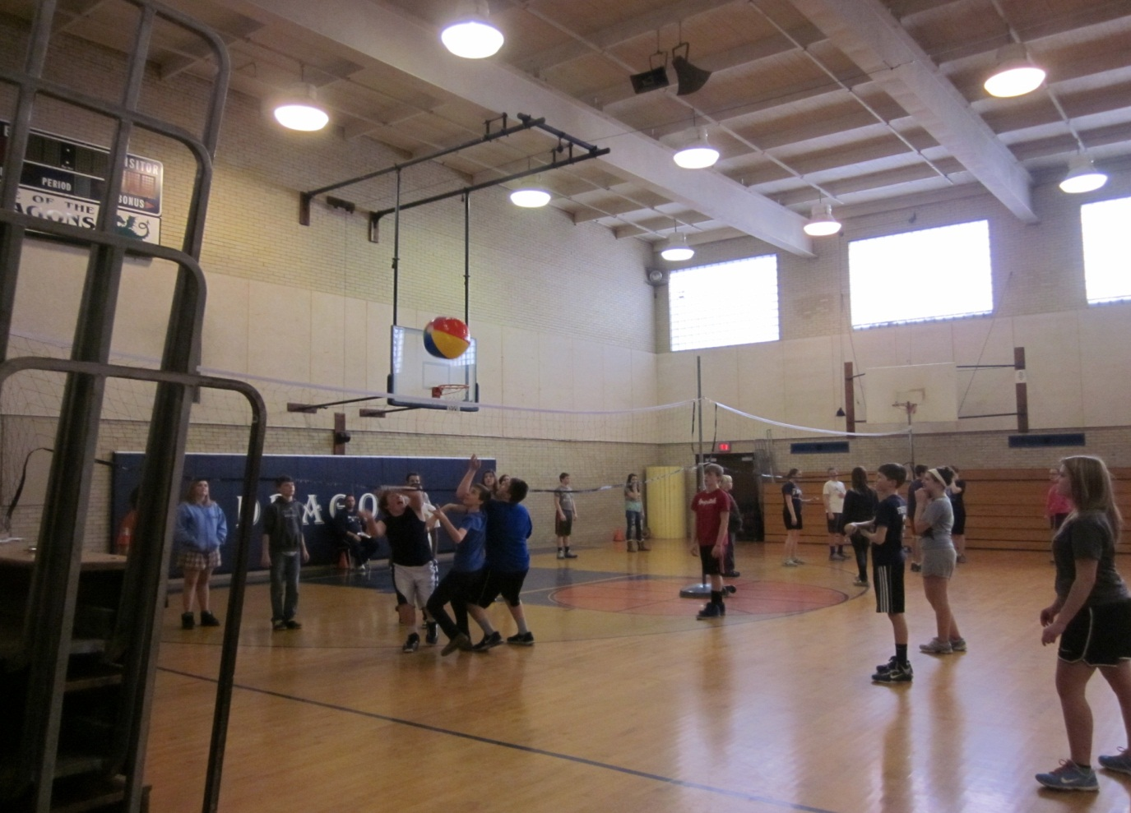
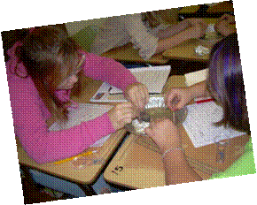
Physical Education classes and Technology Education remain unchanged for 6th, 7th and 8th grades.

Slide 9
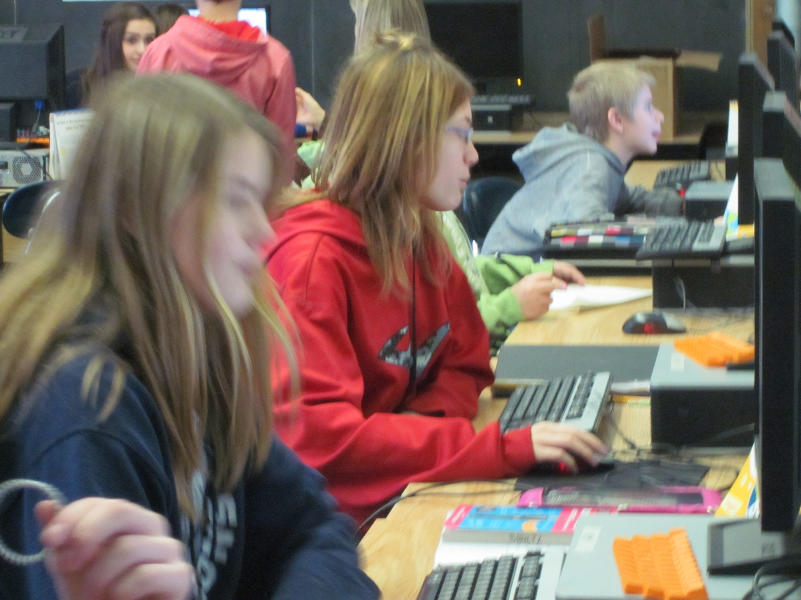
Computers will be available at various times of the day in the Media Center, a small group instruction room, Computer Technology Lab, a classroom, and in the Distance Learning Area.

Slide 10
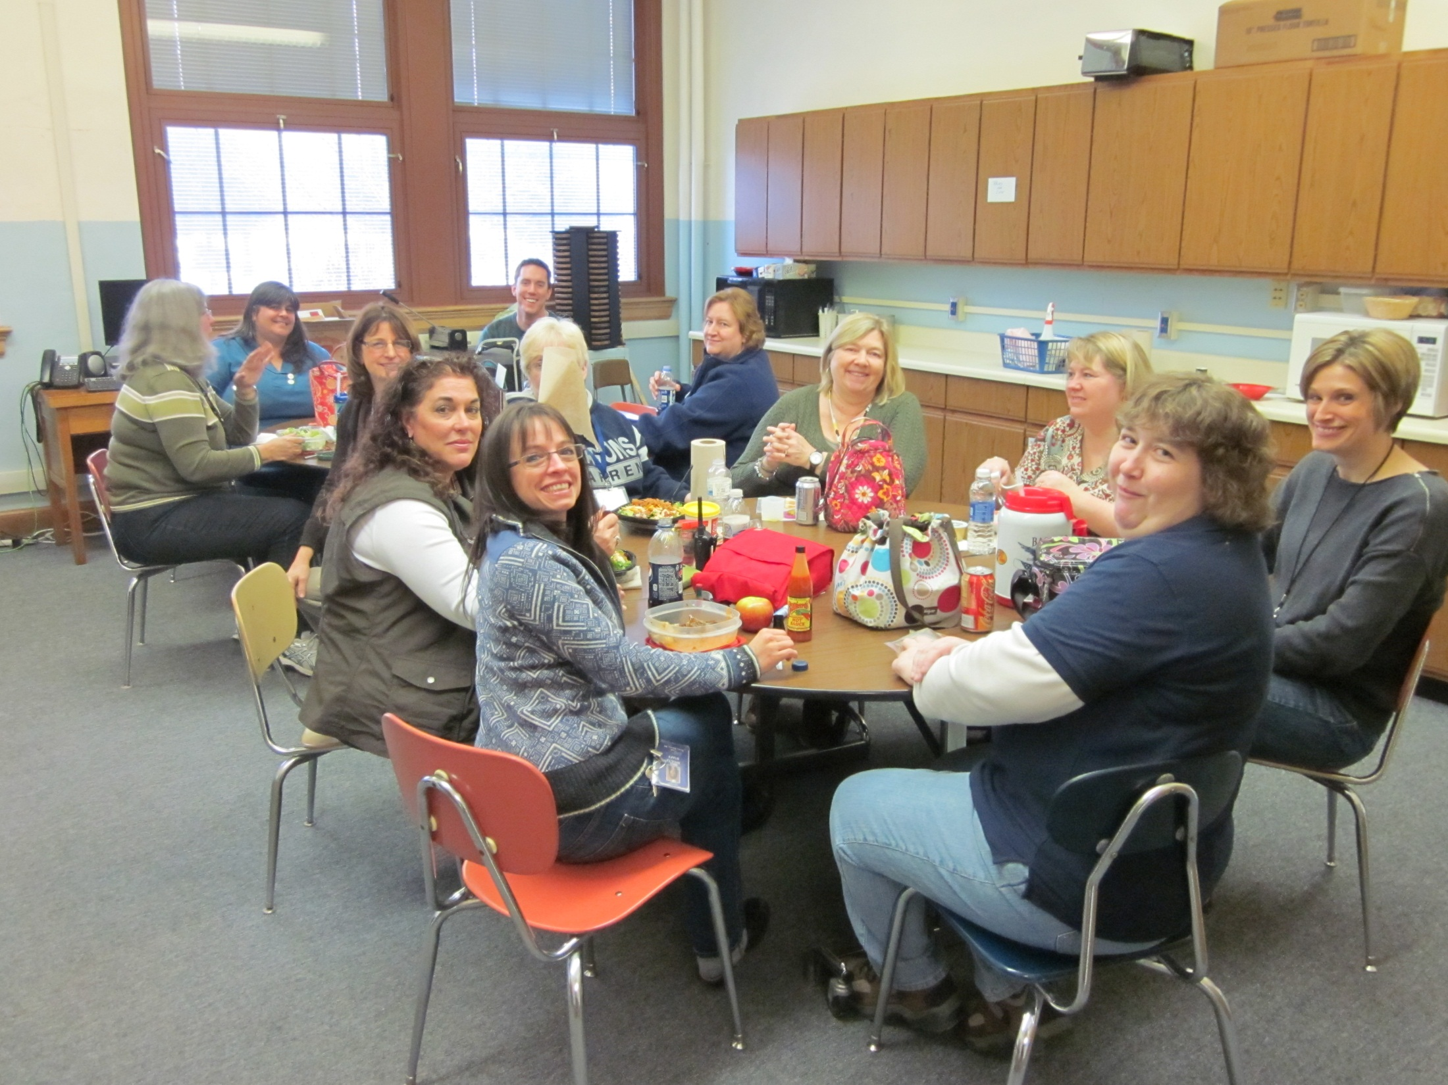
Part of our Family Consumer Science Area will serve as the faculty dining area. The designated faculty dining area will serve as a 6th grade classroom.

Slide 11
Summary of Rooms
Utilization of other Rooms
Nursing-conf. room
Teacher’s Dining Rm.-FCS
Special Education
3 split rooms
Computer Access:
Computer Technology Room
Classroom
Media Center
Distance Learning Area
Small Group Instruction
Technology Education
2 rooms
Computer Technology
1 room
Reading Instruction
2 rooms
Core Instruction
6th grade-
2 classrooms
3 split rooms
7th grade-
7 classrooms
1 science lab
8th grade-
7 classrooms
1 science lab

Slide 12
We look forward to being in our
building at the conclusion of the
BWMS building project!

