Slide 1
“
There’s no such thing as a kid who hates reading. There are kids who love reading and kids who are reading the wrong book!
”
James Patterson

Slide 2
The Literacy Environment
that Transforms Learning

Slide 3
What is myON?
myON is designed to provide a student-centered, personalized literacy environment that offers unlimited access to thousands of enhanced digital books, dynamically matched to each individual learner’s interests and Lexile reading level, along with a suite of literacy tools that foster engagement and achievement.

Slide 4
The Five Pillars of myON

Slide 5
myON: K-12 Personalized Literacy, Online
Includes unlimited & concurrent access to 5,000+
enhanced digital books
Personalized recommendations
Audience appropriate (Grade)
Reading level (Lexile®)
Student interests
Reading scaffolds
Authentic narrated audio
Literacy tools
Word & Sentence highlighting
Embedded Dictionary with pronunciation
Reading & writing connections
Works on all devices, plus offline reading options
Notes:
myON is a personalized digital library environment that provides unlimited access to thousands of enhanced digital books, personalizes recommendations for each individual student based on their on going measured Lexile level and interests while monitoring and measuring their progress and growth as a reader.
myON:
-Over 5000 enhanced digital books
-70% non-fiction 10% Spanish/bilingual
-available 24/7 from any where they can access Internet
-available offline with apps for the major tablets that allow students to download and read books offline without the Internet

Slide 6
Add More Content for Your Students
Meet more standards with additional exemplar texts
Expand fiction, and include popular titles
Extend nonfiction subject and curriculum support
Support special populations:
English language learners
Pre-K and beginning readers
Middle and High school audiences
Further reach for struggling, on-level, and gifted readers

Slide 7
Additional Publishers Available
-Elementary- -Secondary-
Notes:
All Capstone publishers on the left are included in your library. This is currently about 5000+. We add about 600-800 titles per year at no additional cost. Additional publishers are available to add to your collection depending on audience and purpose.

Slide 8
Implementation Levels
Level I
Level III
Level IV
Level II
Independent Reading
Curriculum Connections
Actionable Data
Systemic Adoption
Notes:
Our goal is to build a strong community of readers. For purposes of summer our emphasis will be largely on independent reading. Beyond summer, we focus on a strategic implementation plan for each of our partner schools or district that supports their individual literacy needs and builds toward a full scale systemic adoption utilizing professional development and planning.

Slide 9
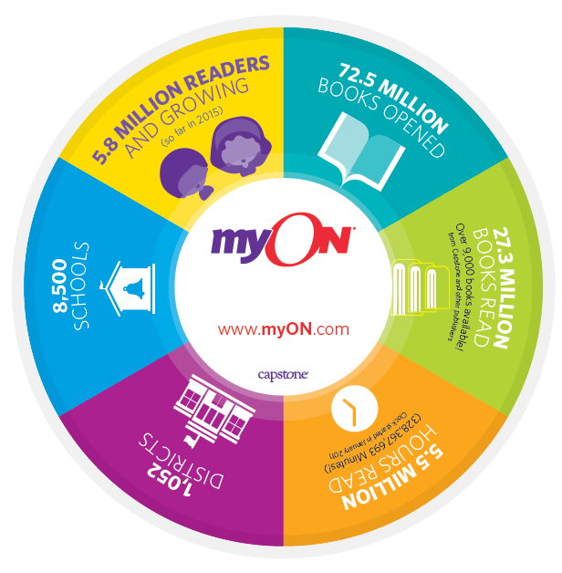
myON Solutions
Achieving Reading Readiness
Succeeding with Standards
Transitioning to the Digital Classroom
Extending the School Day
Growing a Culture of Reading

Slide 10
myON Applications for Instruction
Connecting Reading & Writing to Curriculum:
Whole/Small group instruction
Independent reading
Daily 5
Thematic reading assignments for unit planning
Paired text with fiction/non-fiction
Projects (assigned reading and writing tasks)
Tools to support close reading
Notes:
Beyond Independent Reading, myON can support your teachers in delivering content and instruction in many ways. For example your teachers might choose to incorporate a current science topic like weather into Daily 5 by choosing texts on 5 different types of weather using one for read to self one for read with partner one for a vocabulary, etc.

Slide 11
How it works

Slide 12
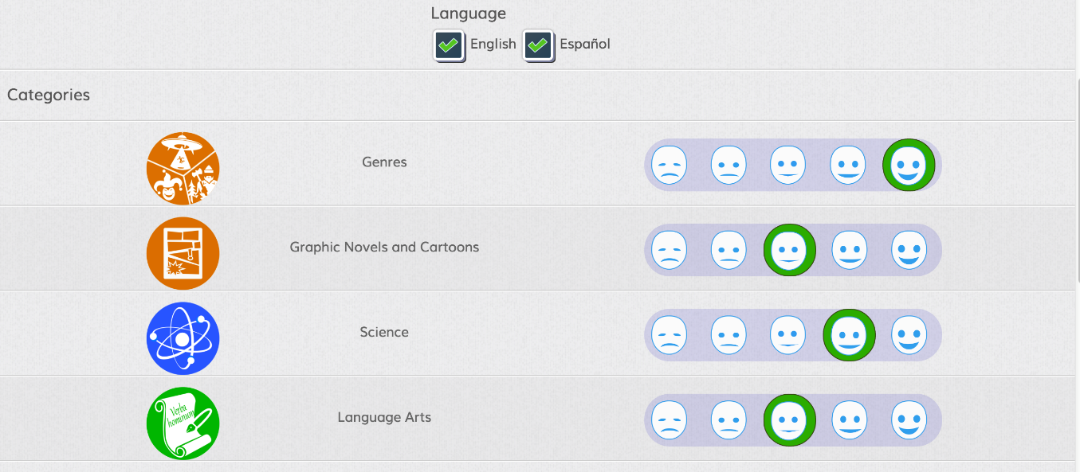
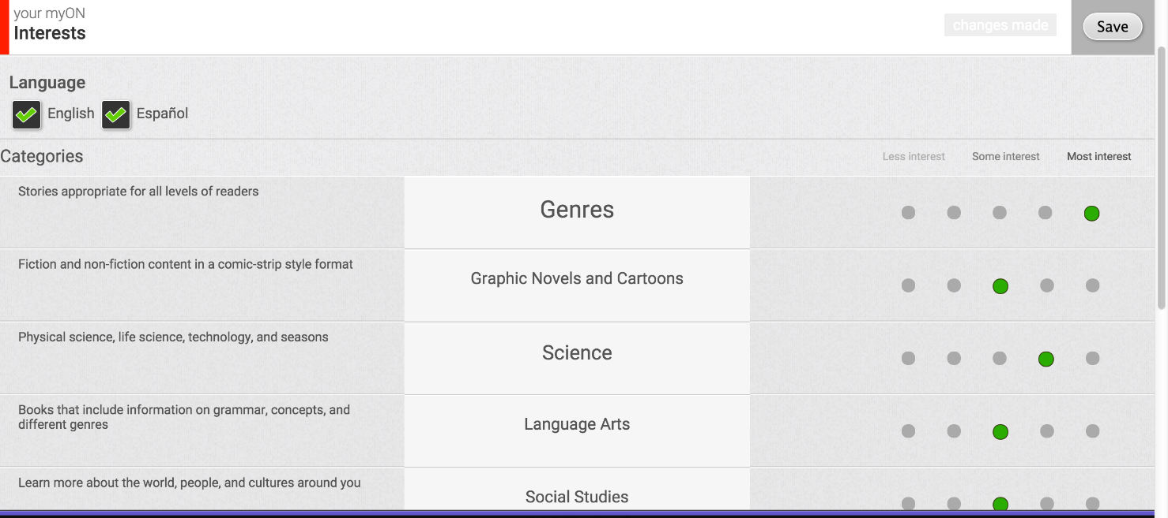
Interest Inventory
Select Interests
Grades 6 and higher
Grades Pre-K to 5
Notes:
When students log in the first time they need to first complete the interest inventory to give myON a beginning understanding of their likes and dislikes.

Slide 13
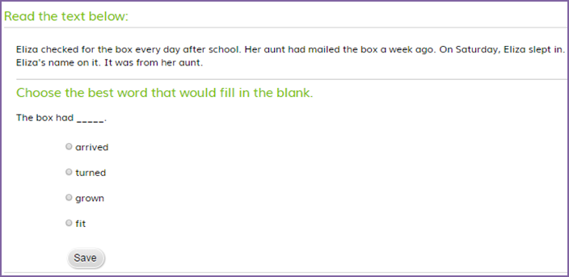
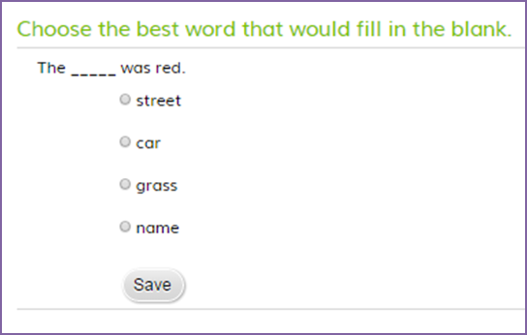
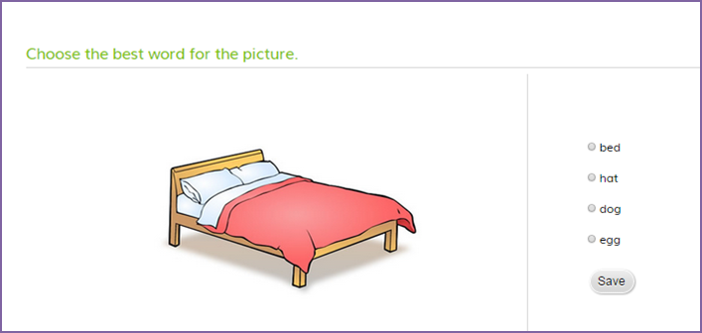
Placement Exam (K-1)
Different questions & question types by grade
Notes:
After completing the Interest Inventory, they will be asked to complete an adaptive Lexile Assessment that provides a beginning measurement of their Lexile score.
Grades K-1 start with simple picture progress to simple sentences and then simple questions.
Grades 2+ have a series of short passages with multiple choice.
Assessment is adaptive. Max 35 questions, Max 30 minutes. When a student misses 4 in a row it automatically ends the assessment and takes them to the library.

Slide 14
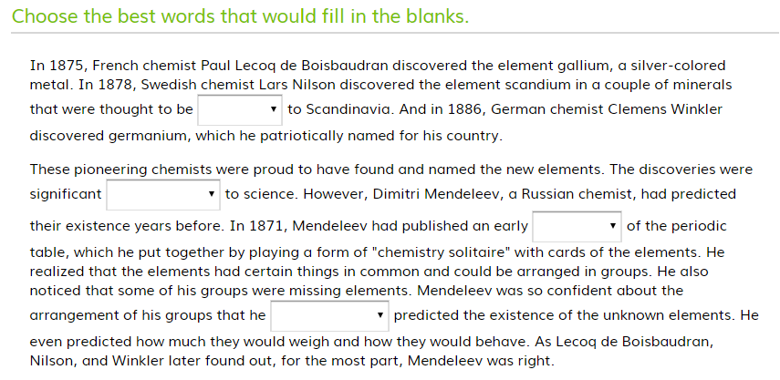
Placement Exam (Grades 2-12)
On-going Benchmarks
Notes:
On an on-going basis myON measures a student’s growth as a reader. Approximately every two weeks after a student has read at least 5 books or 3 hours they will take a benchmark assessment to remeasure their Lexile score and growth. Once they have completed the Benchmark, myON adjusts their Lexile level and their recommended books.

Slide 15
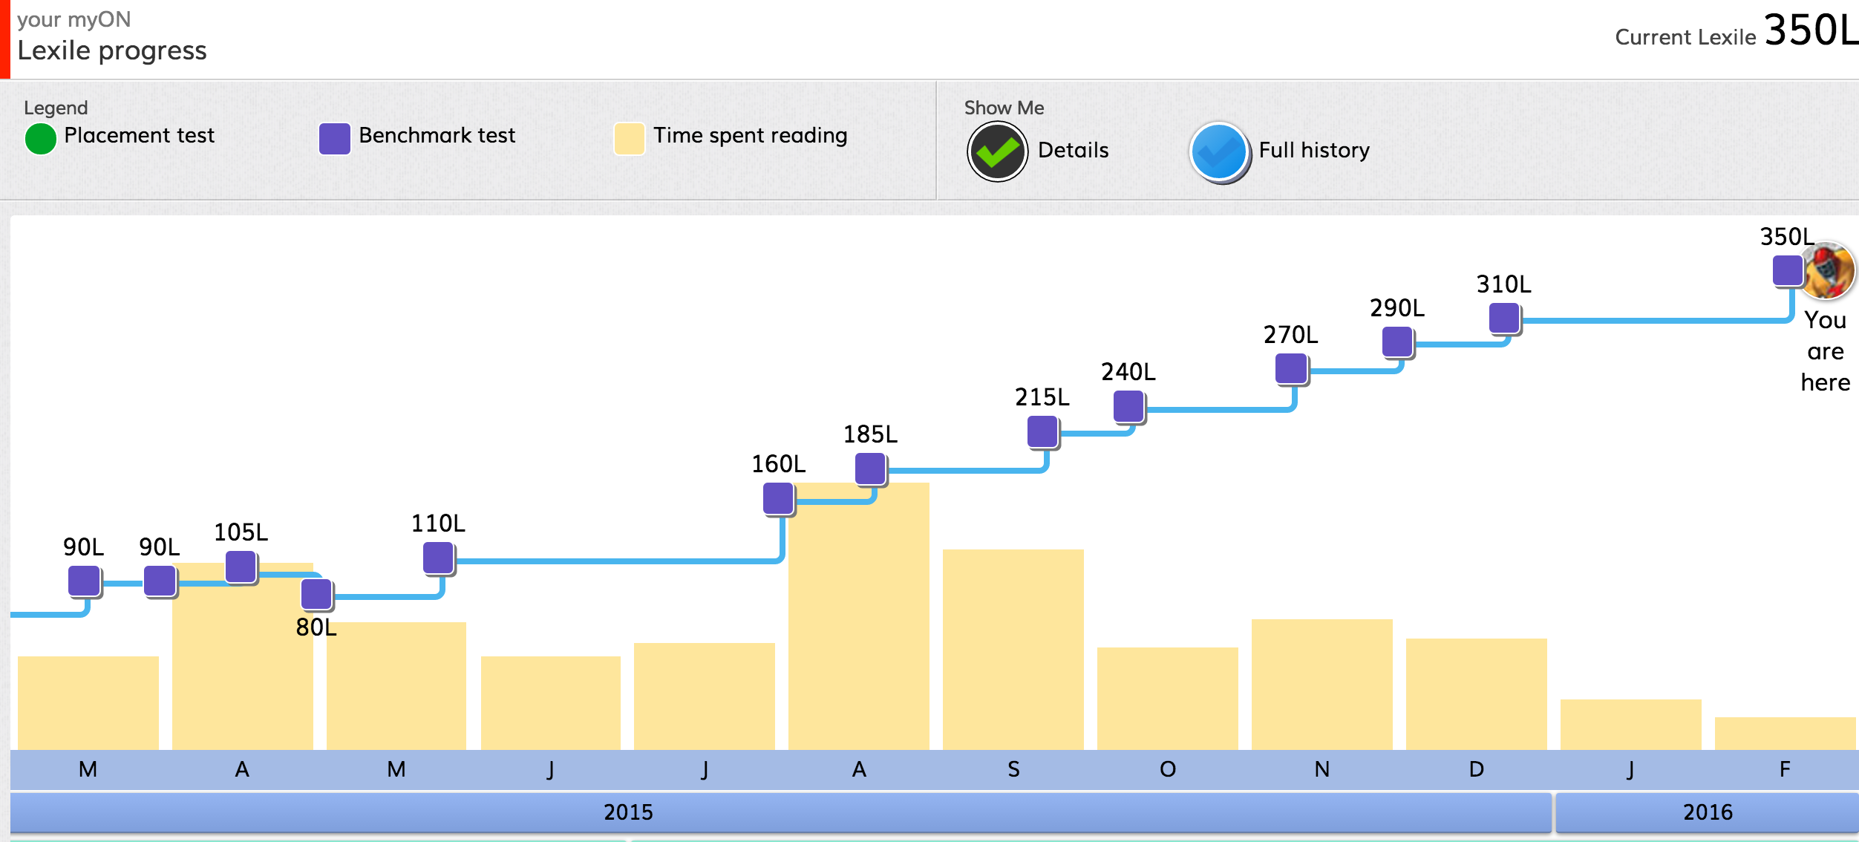
Data for Student Directed Learning
Notes:
myON tracks and provides student’s progress with data so they can direct their own learning. This is a screenshot of a student’s growth chart. He can see on any given day how much he has progressed as a reader this year. This visual gives him a sense of accomplishment and is great to share with parents.

Slide 16
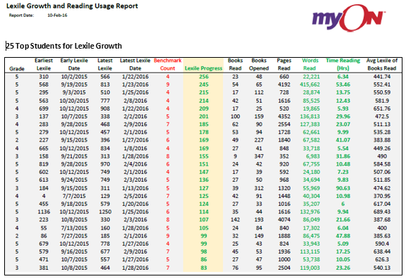
Data to Guide Differentiated Instruction
Notes:
In addition to the quick data dashboard I showed you while on the teacher dashboard, myON provides several deeper dive reports that can be used to guide instruction in the classroom, school and district. On your screen is a sample report that was put together from the Lexile Growth report to look at the correlation between time spent reading and Lexile progress. This ties nicely back to the the 10 minutes of incremental reading graphic we discussed at the beginning of our time. More time reading on level does equate to more growth as a reader.

