Slide 1
WARREN COUNTY SCHOOL DISTRICT
PA Cyber Charter:
What does it mean to have “school choice” in PA

Slide 2
Charter School Origin and Concept
Charter Schools are public schools that are authorized to operate independently from traditional public schools.
Pa Charter Law was adopted in 1997 and amended for Cyber in 2002.
According to the Charter School Law, charter schools were created to:
Improve student learning
Increase educational opportunities (competition) for students
Encourage the use of different and innovative teaching methods
Create additional professional opportunities for teachers
Exempt from many Public School mandates

Slide 3
Is it really about the education or $?
Cyber Charter school students are selected on a “random basis”.
25% of teachers do NOT have to be appropriately certified.
Charter Schools are NOT required to use the Classroom Teacher Effectiveness Evaluation model that public schools are required to use.
Advertise “FREE” tuition but it actually comes directly from public school budgets.
Ability to hold substantial reserves as evidenced through AFR’s.
Permitted to invest in non-collateralized investments.
Large marketing & lobbying campaigns using taxpayer funds.

Slide 4
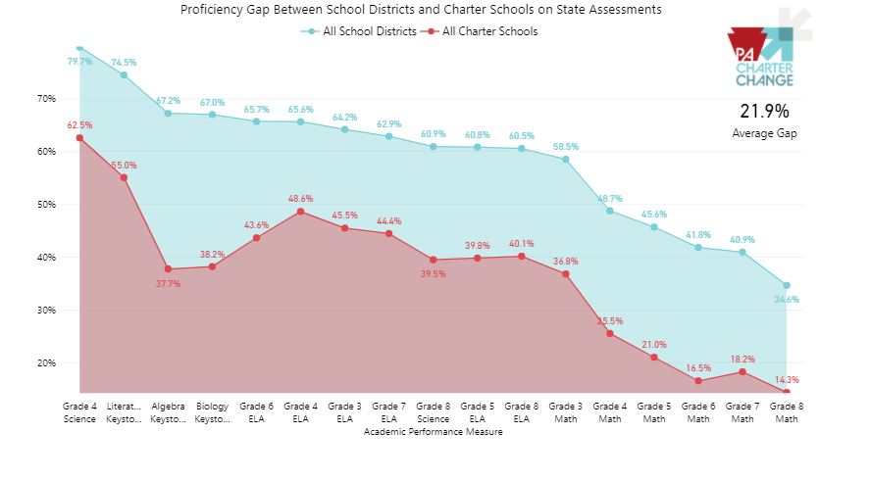
Proficiency: Public Schools vs. Charter

Slide 5
Graduation Rates
 | 2015 |  | 2016 |  | 2017 | 2018 | 2019 | 5 Year Avg | 2020-21 WCSD Students | Potential Dropouts
Keystone Education Charter School | 64.0% |  | 62.5% |  | 44.7% | 60.8% | 57.5% | 57.9% | 0 | 0
PA Leadership Charter School | 69.7% |  | 71.4% |  | 70.8% | 75.5% | 77.2% | 72.9% | 1 | 0
Warren County School District | 89.8% |  | 88.0% |  | 91.2% | 88.3% | 88.1% | 89.1%
Insight PA Cyber Charter School | 0.0% |  | 0.0% |  | 0.0% | 0.0% | 0.0% | 58.0% | 6 | 3
Achievement House Charter School | 36.3% |  | 41.7% |  | 48.8% | 52.8% | 45.9% | 45.1% | 2 | 1
Agora Cyber Charter School | 46.2% |  | 41.2% |  | 45.2% | 48.7% | 49.4% | 46.1% | 17 | 9
PA Cyber Charter School | 58.1% |  | 54.6% |  | 50.3% | 49.6% | 49.5% | 52.4% | 59 | 28
PA Distance Learning Charter School | 34.3% |  | 53.3% |  | 69.7% | 60.7% | 52.5% | 54.1% | 6 | 3
21st Century Cyber Charter School | 66.7% |  | 66.7% |  | 62.2% | 54.2% | 61.3% | 62.2% | 4 | 2
Reach Cyber Charter School | 0.0% |  | 0.0% |  | 0.0% | 0.0% | 62.7% | 62.7% | 13 | 5
Commonwealth Charter Academy | 73.2% |  | 65.8% |  | 68.2% | 65.7% | 53.5% | 65.3% | 11 | 4
PA Virtual Charter School | 77.4% |  | 81.0% |  | 67.8% | 78.0% | 75.7% | 76.0% | 6 | 2
 |  |  |  |  |  |  |  | 58.0% | 125 | 55
No graduation rate data was available for Insight Pa Cyber Charter School so a average of Cyber Charter
school's was used.

Slide 6
What is the Impact on WCSD Students?
5 Year Avg | 2020-21 WCSD Students | Potential Dropouts
58% | 125 | 55
Approximately 1 out of every 2 of our children attending outside Cyber Charter Programs will not graduate!

Slide 7
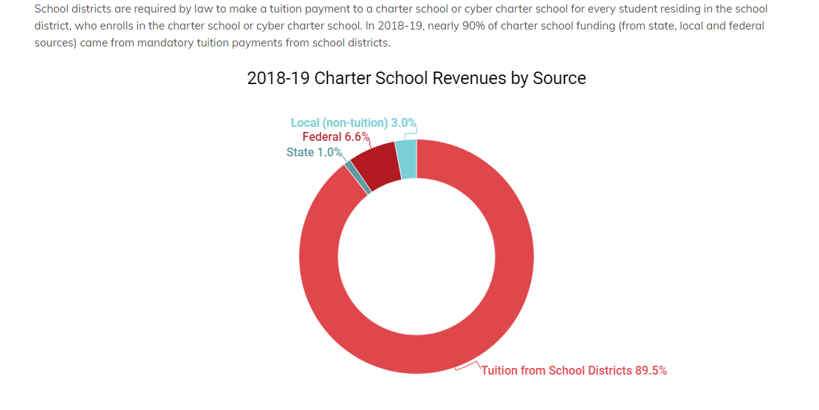
Who pays the Charter School Tuition?

Slide 8
What does this “education” cost?

Slide 9
What does this “education” cost?

Slide 10
What is Millage Comparison?
Year |  | Cyber Charter | $400k = 1 Mill | All Charter | $400k = 1 Mill
2014-15 |  | $ 1,065,376 | 2.66 | $ 3,650,000 | 9.13
2015-16 |  | $ 1,140,925 | 2.85 | $ 3,853,441 | 9.63
2016-17 |  | $ 1,142,872 | 2.86 | $ 4,348,298 | 10.87
2017-18 |  | $ 1,133,780 | 2.83 | $ 4,567,037 | 11.42
2018-19 |  | $ 1,433,723 | 3.58 | $ 4,827,272 | 12.07
2019-20 |  | $ 1,547,468 | 3.87 | $ 5,005,904 | 12.51
2020-21 est |  | $ 1,978,898 | 4.95 | $ 5,561,800 | 13.90
TOTAL TAXPAYER COST |  | $ 9,443,041 | 23.61 | $ 31,813,752 | 79.53
 |  | CURRENT MILLAGE FOR WCSD ID 55.3371 MILLS/YR

Slide 11
Summary
Outside Cyber Charter School’s have more flexibility with Teacher certifications.
Outside Cyber Charter School’s demonstrate poor academic results with lower achievement scores & lower graduation rates.
You, THE TAXPAYER, pay for the “tuition free” fees to send WCSD students to a Cyber Charter.
Costs for Charter Schools are increasing at an alarming and increasing rate!!
District’s who offer their own cyber options for students must still pay for students who attend outside cyber schools. However, if a student wants a “different experience” and decides to attend a non-public school, the parents have to pay for this education.

