Slide 1
FEBRUARY 2022
Food Service Report
WARREN COUNTY
SCHOOL DISTRICT
Bringing your Cafeteria to you!

Slide 2
Industry Outlook
What’s Happening in the News

Slide 3
February is American Heart Month
School Lunch and Breakfast promote heart health every day

Slide 4
Staying Ahead of the Challenges
A few updates from our Corporate Purchasing Team and the supply chain
Although transit times remain elongated and uncertain, market normalization trend show an expected gradual return towards 2024.
While a few General Mills products had to be pulled due to ingredient/transportation/labor constraints, temporary substitutions are available to cover this gap in the meantime.
Mini pancakes are scheduled to come back in April!
Product shortages continue to affect us; however our vendors are proactively communicating inventory substitutions, weather delays, transportation issues, etc.

Slide 5
Behind the Scenes
An Update from the TNG Marketing Department

Slide 6
Behind the Scenes
An Update from the TNG Marketing Department

Slide 7
Behind the Scenes
An Update from the TNG Marketing Department

Slide 8
Behind the Scenes
Check out these eye-catching ways we use to promote our programs!

Slide 9
Behind the Scenes from our Corporate Chef

Slide 10
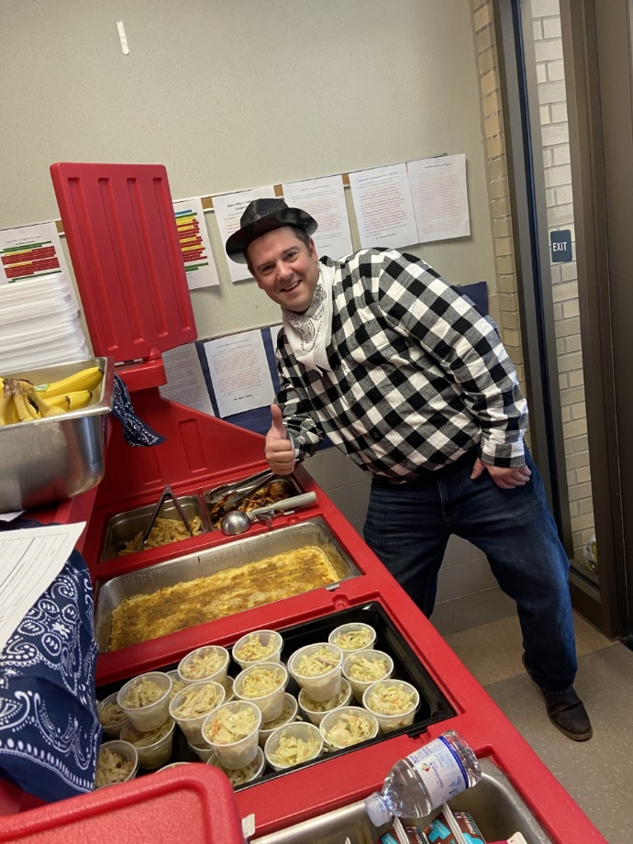
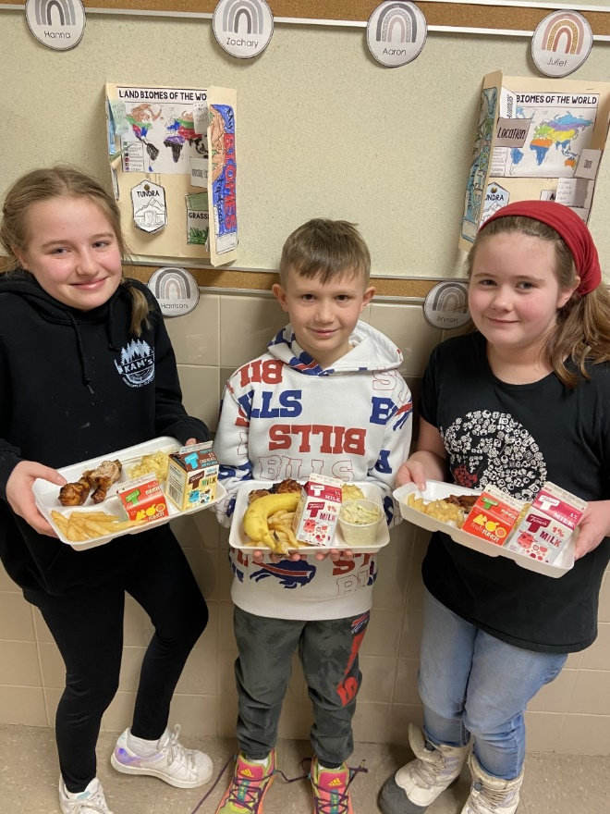
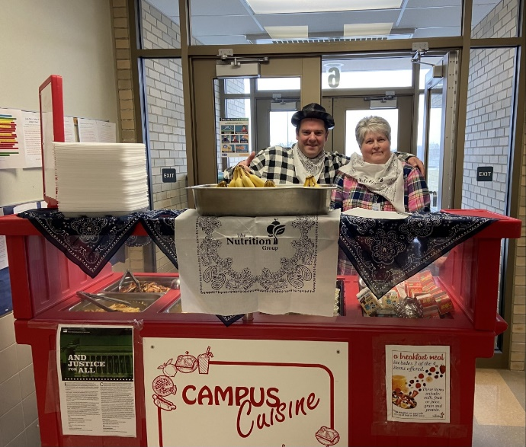
Classroom Parties- Yeehaw
TNG is always on board for a fun Classroom Luncheon or Party
A yeehaw good time was had by all in the EES 4th grade when their teacher ordered a special Western Classroom Luncheon.

Slide 11
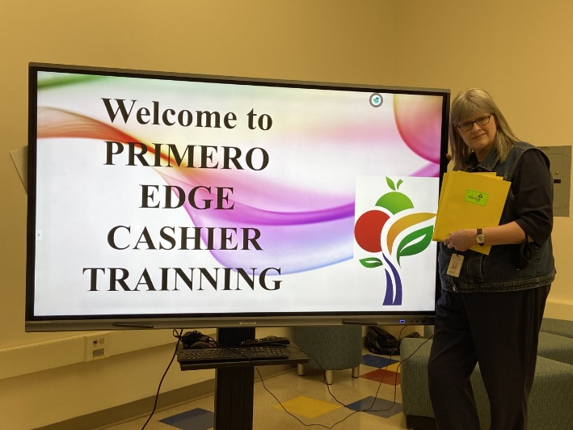
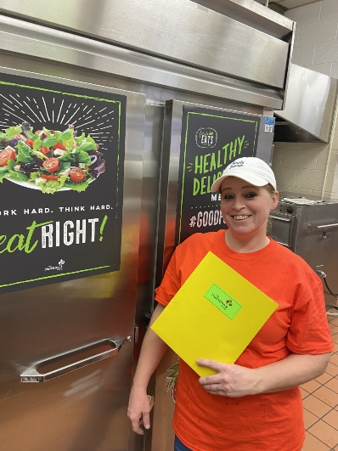
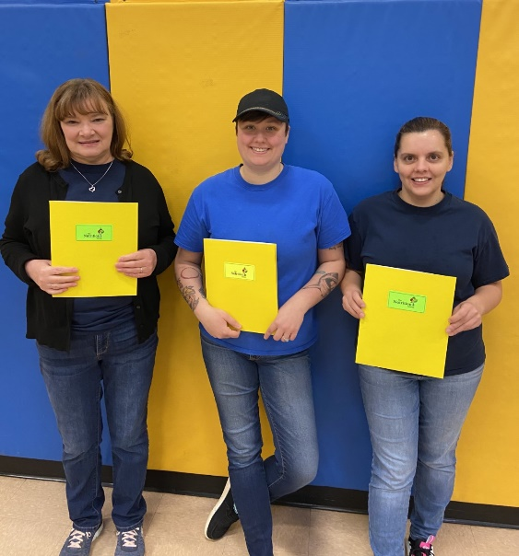
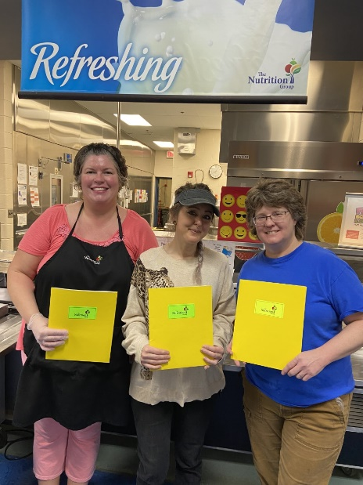
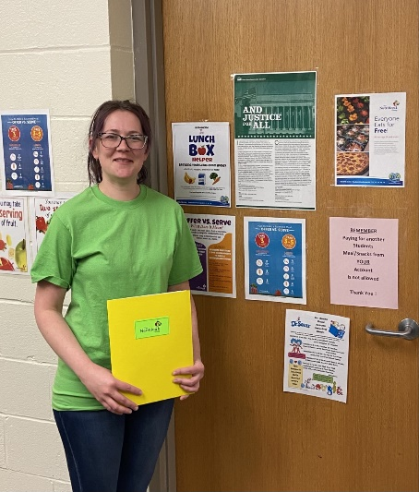
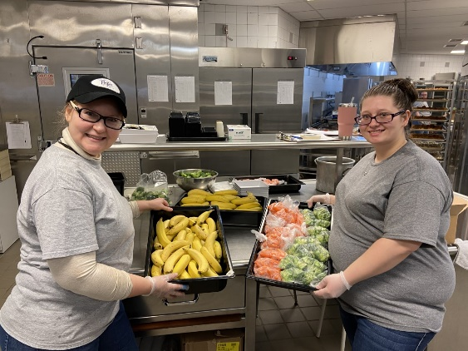
New Employee Training
Welcome to the Warren County Food Services Department
On February 21, 2022 TNG held a Professional Development Day Training for our new employees. Welcome ☺
EMHS/EES
SAMHS/SAES
YES
BWMS
WAEC

Slide 12
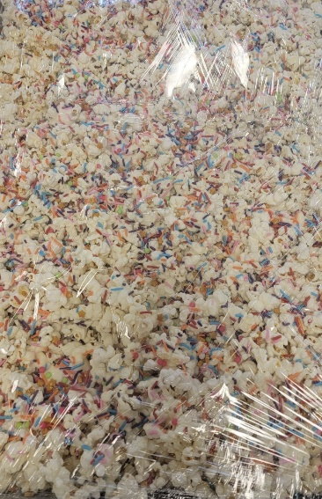
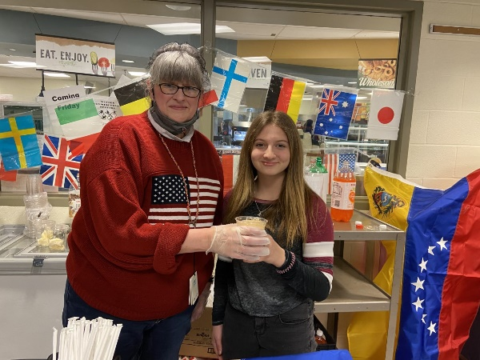
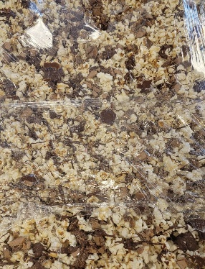
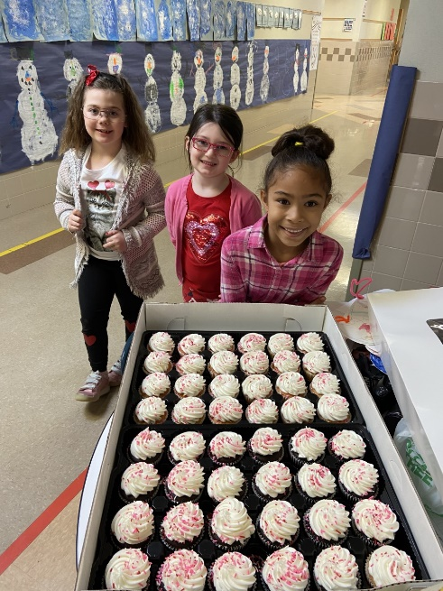
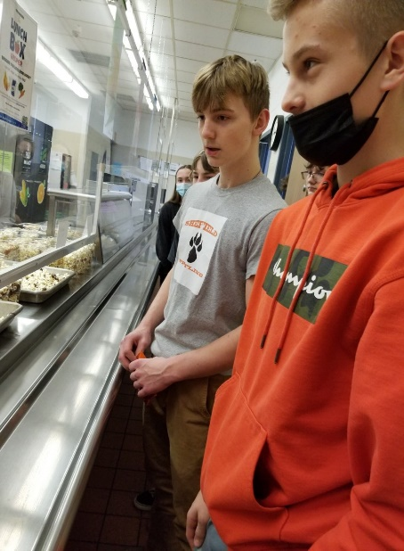
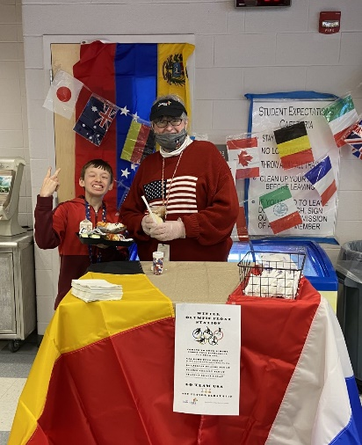
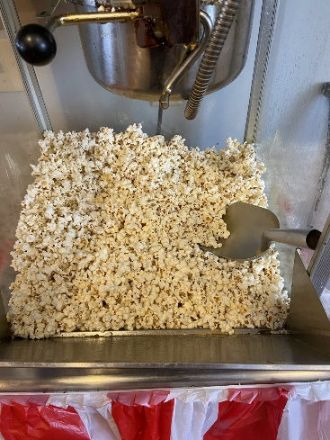
A February Filled with Special Events
February was busy
February was filled with
100th Day Celebrations
Valentine’s Parties
Olympic Float Stations
Honor/Merit Roll Events
This Photo by Unknown Author is licensed under CC BY-SA-NC
This Photo by Unknown Author is licensed under CC BY-NC

Slide 13
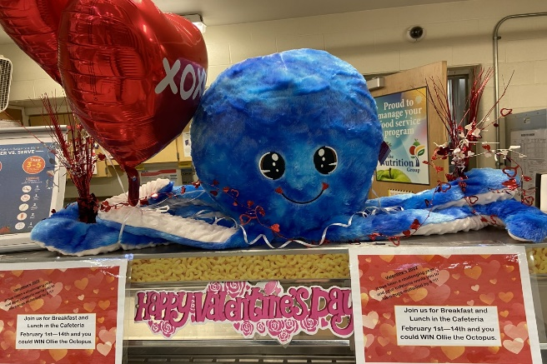
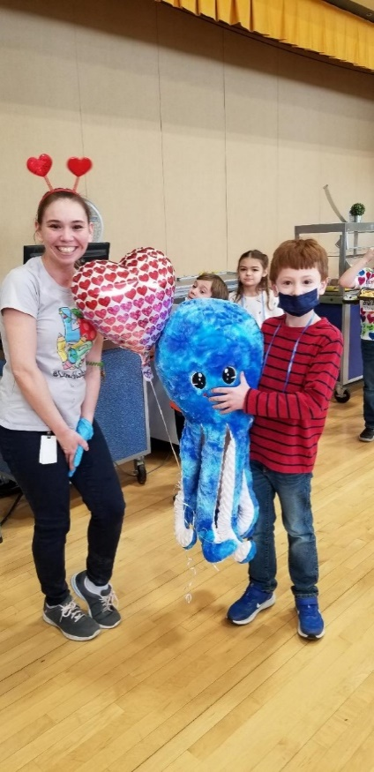
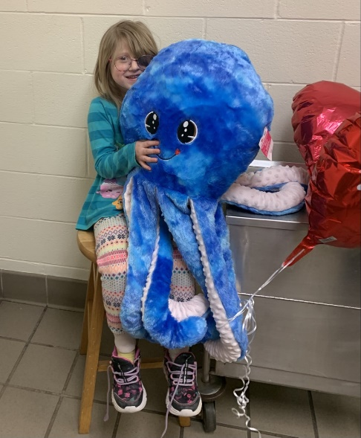
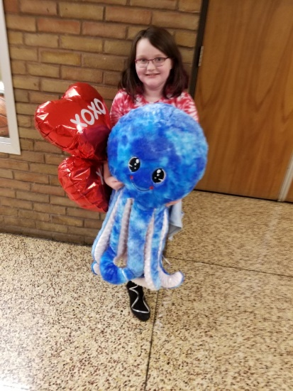
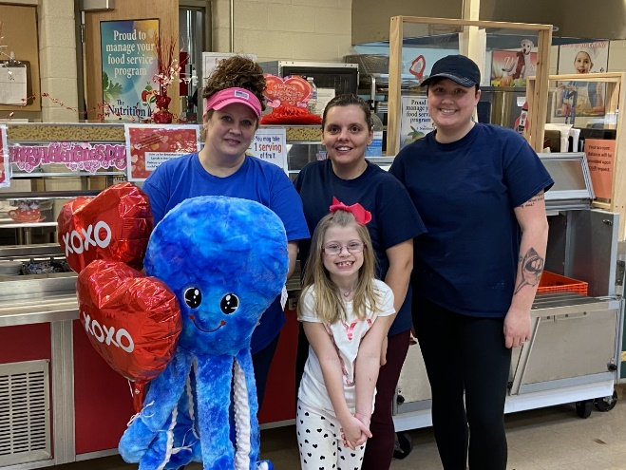
A Special Valentine’s Day
TNG held a Special Valentine’s Day giveaway in each Elementary School.
For Valentine’s Day the Food Service Staff just wanted to give away some extra warm hugs.
Who better than Ollie the Octopus who can hug with 8 soft arms. Every student who received a reimbursable meal from February 1-14 was eligible to win. Congratulations to those students who went home with a new friend on Valentine’s Day from TNG.
This Photo by Unknown Author is licensed under CC BY-SA-NC

Slide 14
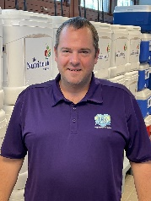
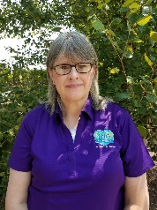
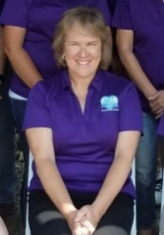
Thank You!
Your Food Service Team:
SCOTT JOHNSON, FSD
CANDY RIEDER, ASSISTANT FSD
DEB MIKTUK, FSD TRAINEE
Food Service Directors
814-723-6900 ext 1600
johnsonst@wcsdpa.org
Follow us on:
@TheNutritionGroup
@TNG_Corporate
MELISSA KINGEN
Regional Manager
814-720-1140
mkingen@thenutritiongroup.biz
@TheNutritionGroup

