Slide 1
Warren County School District Overview of Boiler Systems
Prepared by: Department of Buildings & Grounds
October 2011

Slide 2
The average life cycle of a boiler is 25 years.
- Source: EnergyStar Website
Boiler Rating System:
(based on age and efficiency)
4 Best
3 Good
2 Fair
1 Poor

Slide 3
Russell Elementary School
Amount / Type: 2 hot water boilers
Manufacturer / Year: RBI, 2003
Rating: 4

Slide 4
Warren Area Elementary Center
Amount / Type: 3 hot water boilers
Manufacturer / Year: RBI, 2003
Rating: 4

Slide 5
Warren County Career & Technical Center
Amount / Type: 2 hot water boilers
Manufacturer / Year: Weil McLain, 2006
Rating: 4

Slide 6
Youngsville High School
Amount / Type: 2 hot water modulating boilers
Manufacturer / Year: Patterson-Kelley, 2010
Rating: 4

Slide 7
South Street Early Learning Center
Amount / Type: 2 hot water boilers
Manufacturer / Year: Patterson-Kelley, 1999
Rating: 3

Slide 8
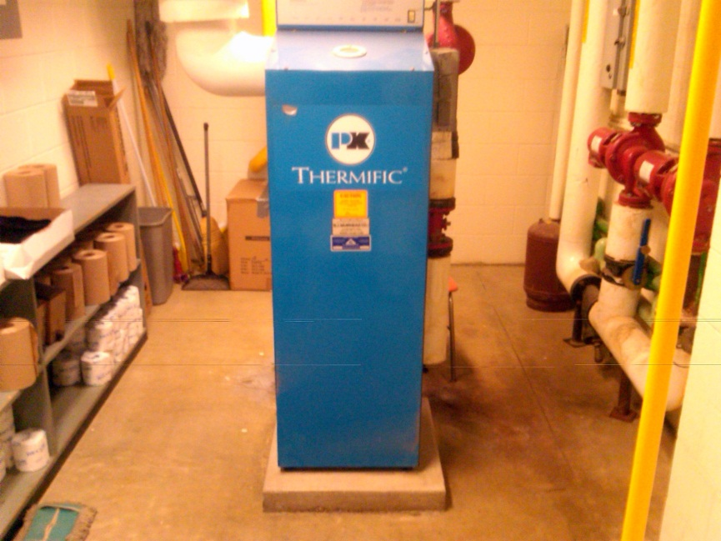
Youngsville Elementary Middle School
Amount / Type: 3 hot water boilers
Manufacturer / Year: Patterson-Kelley, 1999 (2) & 2001 (1)
Rating: 3

Slide 9
Allegheny Valley Elementary School
Amount / Type: 2 hot water boilers
Manufacturer / Year: Weil McLain, 1996
Rating: 2

Slide 10
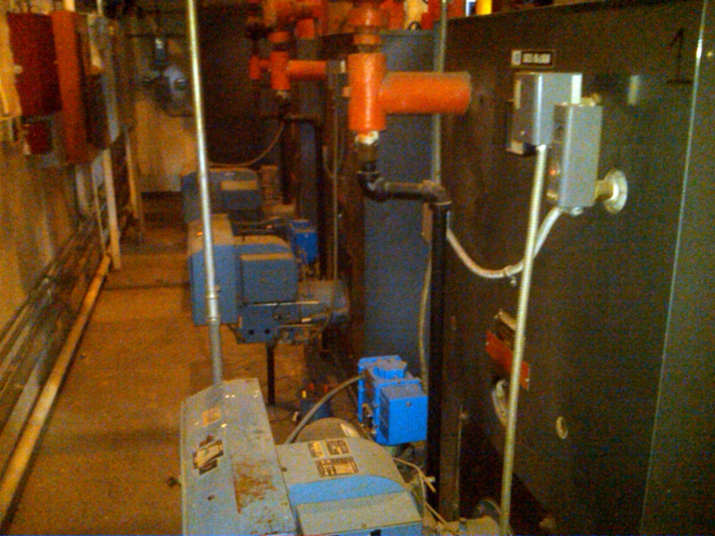
Beaty Warren Middle School
Amount / Type: 3 hot water boilers
Manufacturer / Year: Weil McLain, 1983 (2) & 1991(1)
Rating: 1 & 2

Slide 11
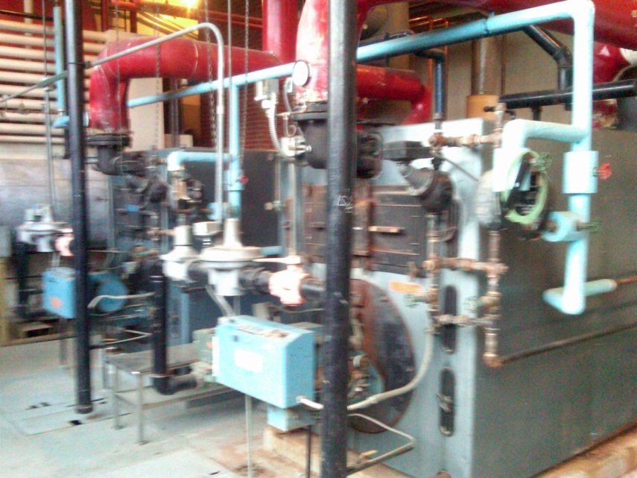
Eisenhower Middle Senior High School
Amount / Type: 2 steam boilers
Manufacturer / Year: Weil McLain, 1980
Rating: 1

Slide 12
Sheffield Area Middle / High School
Amount / Type: 2 hot water boilers
Manufacturer / Year: Weil McLain, 1975
Rating: 1

Slide 13
Sheffield Elementary School
Amount / Type: 2 hot water boilers
Manufacturer / Year: Weil McLain, 1981
Rating: 1

Slide 14
Sugar Grove Elementary School
Amount / Type: 2 hot water boilers
Manufacturer / Year: Weil McLain, 1986
Rating: 1

Slide 15
Warren Area High School
Amount / Type: 3 hot water boilers
Manufacturer / Year: Weil McLain, 1982
Rating: 1

Slide 16
Warren County Career Center
Amount / Type: 2 hot water boilers
Manufacturer / Year: Peerless, 1971
Rating: 1

